Slide 1
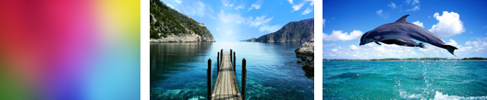
Experiment blending 3 images
Groups: Minh Truong, Fei Xu, Floyd R

Slide 2

GLTextureBase
Triple_Texture
GLMultiTexture
Copy and modify
int TripleTexture::loadAndCreateTextures(string path_and_file_texture_1, string path_and_file_texture_2, string path_and_file_texture_3)

Slide 3
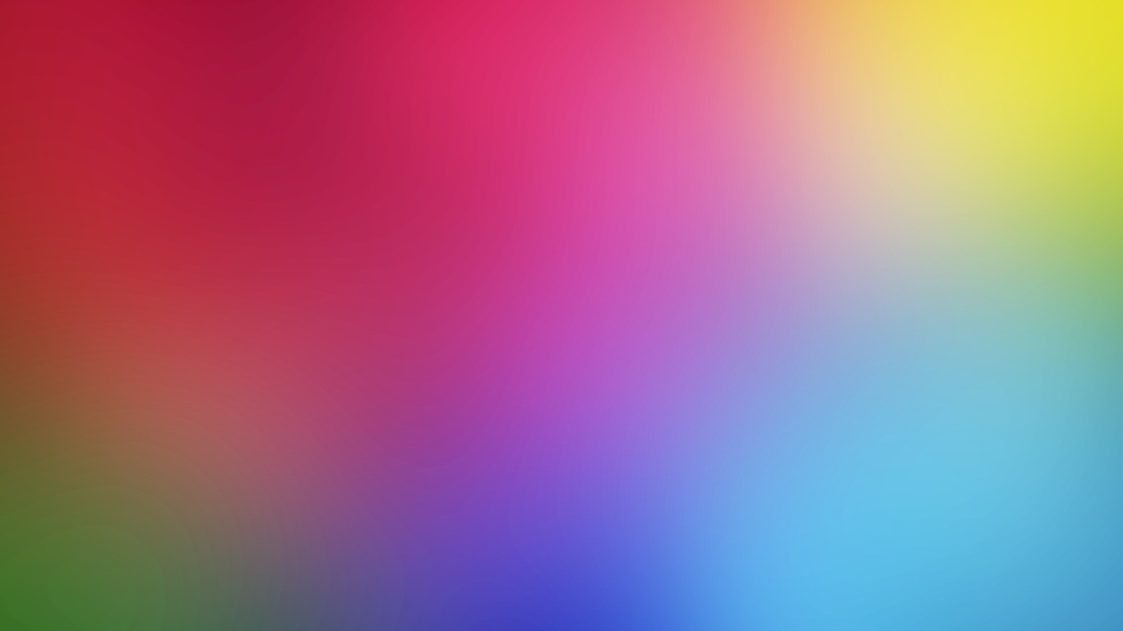
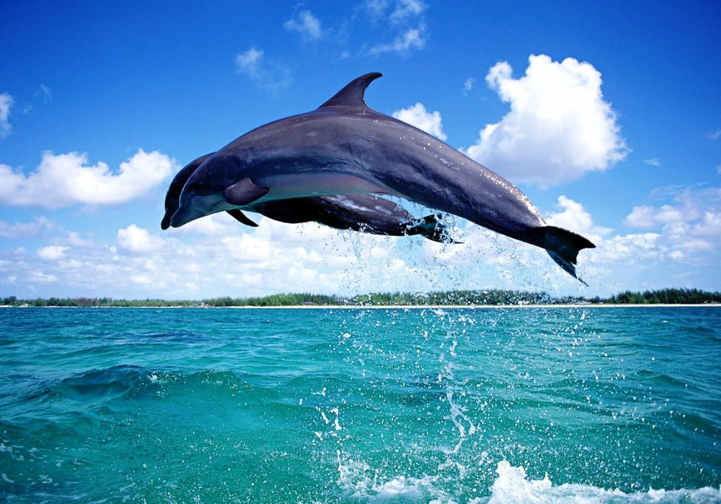
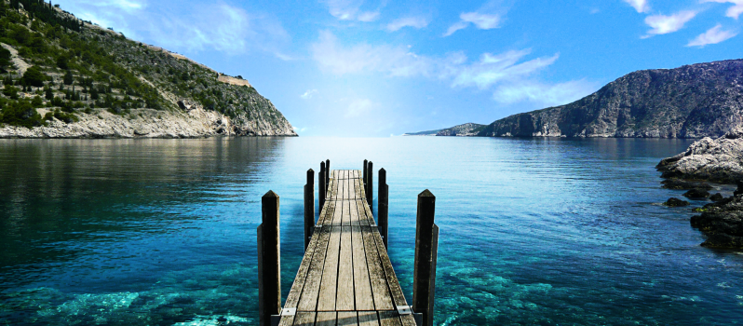

Slide 4
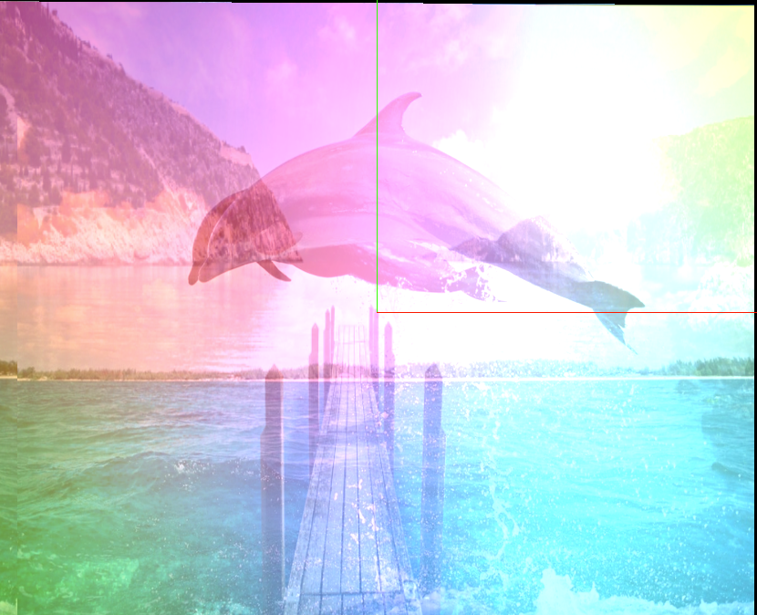
color = 0.1 * pass_Color + 0.3 * tex_color + 0.8 * tex_color_light + 0.4 * tex_color_extra;

Slide 5
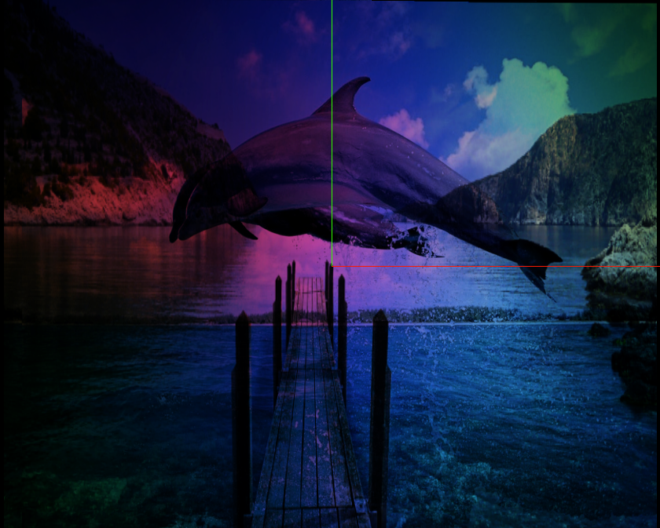
color = tex_color * tex_color_light * tex_color_extra

Slide 6
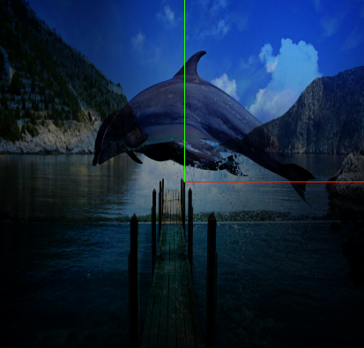
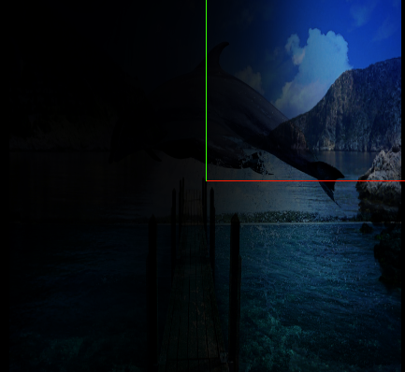
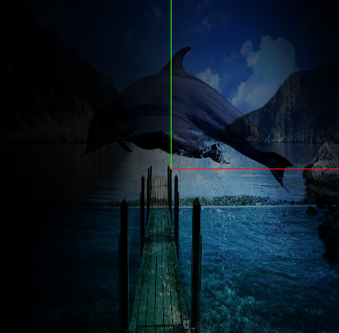
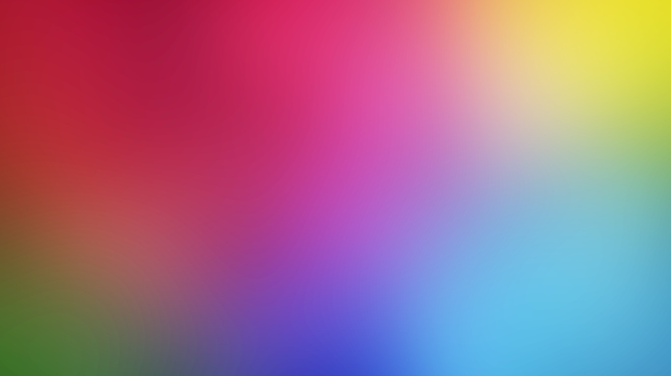
(tex_color_light.r)*tex_color * tex_color_extra
red
Blue

Slide 7
Challenges
Adding the third image
How to map each texture into separate coordinates in the same model ? (still not answer)
-> choose images that fit the default mapping (mapping each image into 4 corners of the plane)

Slide 8
Combining a Colormap with a Noisemap
Groups: Minh Truong, Fei Xu, Floyd R

Slide 9
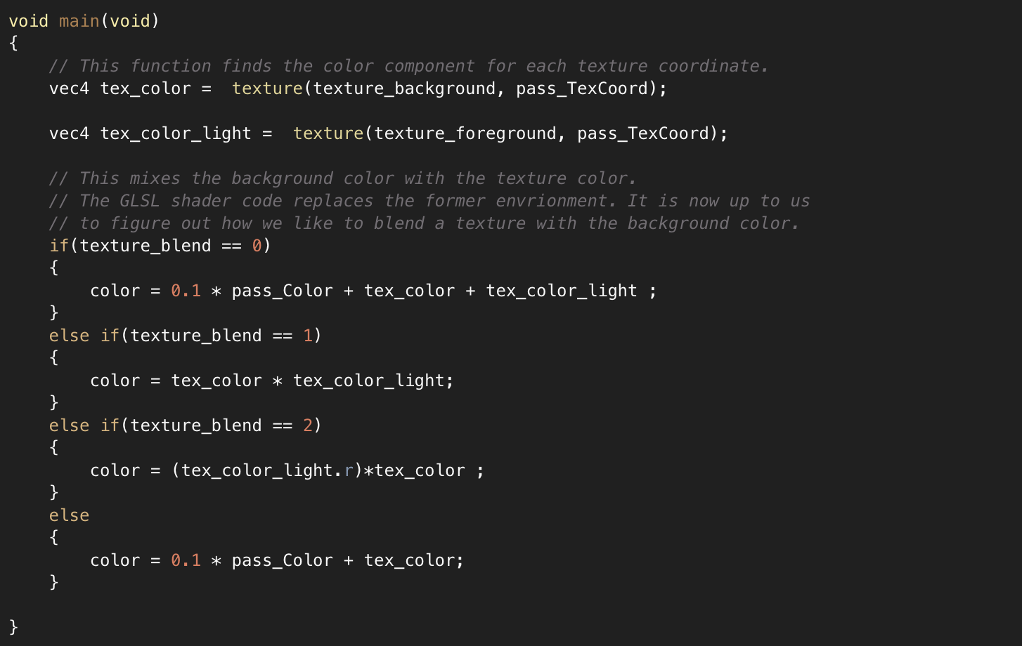
Multi-Texture

Slide 10
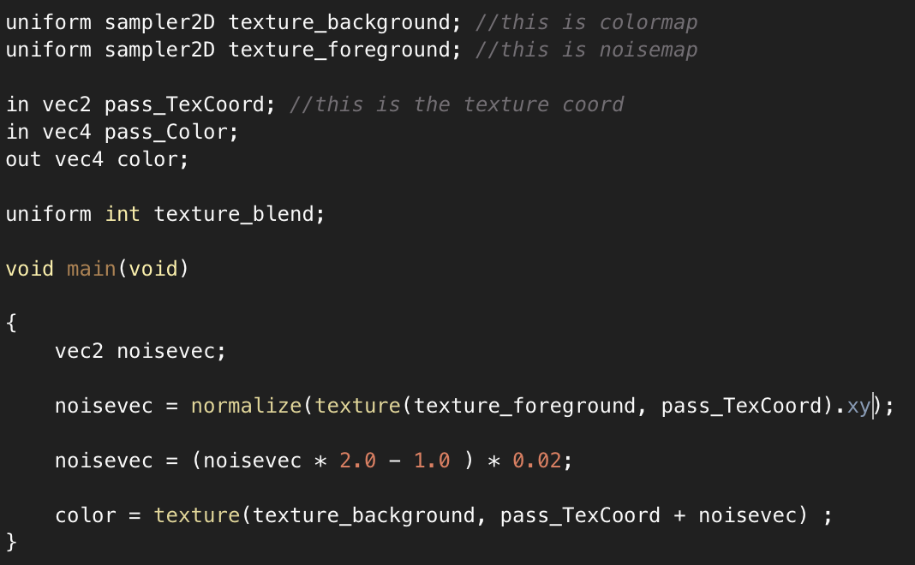
New fragment shader code

Slide 11

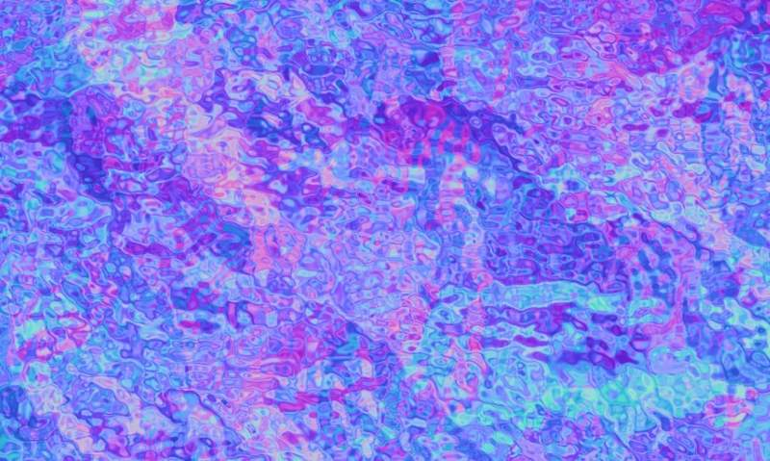
The colormap: a land scape
a noisemap

Slide 12
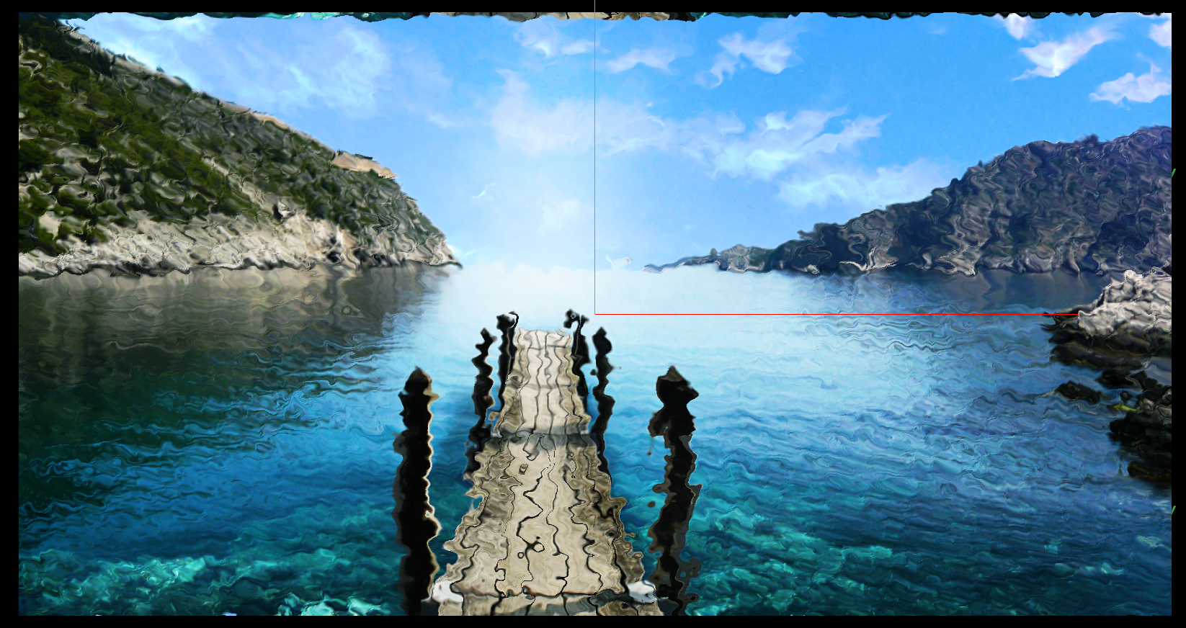
Results
noisevec = (noisevec * 2.0 - 1.0 ) * 0.02;

Slide 13
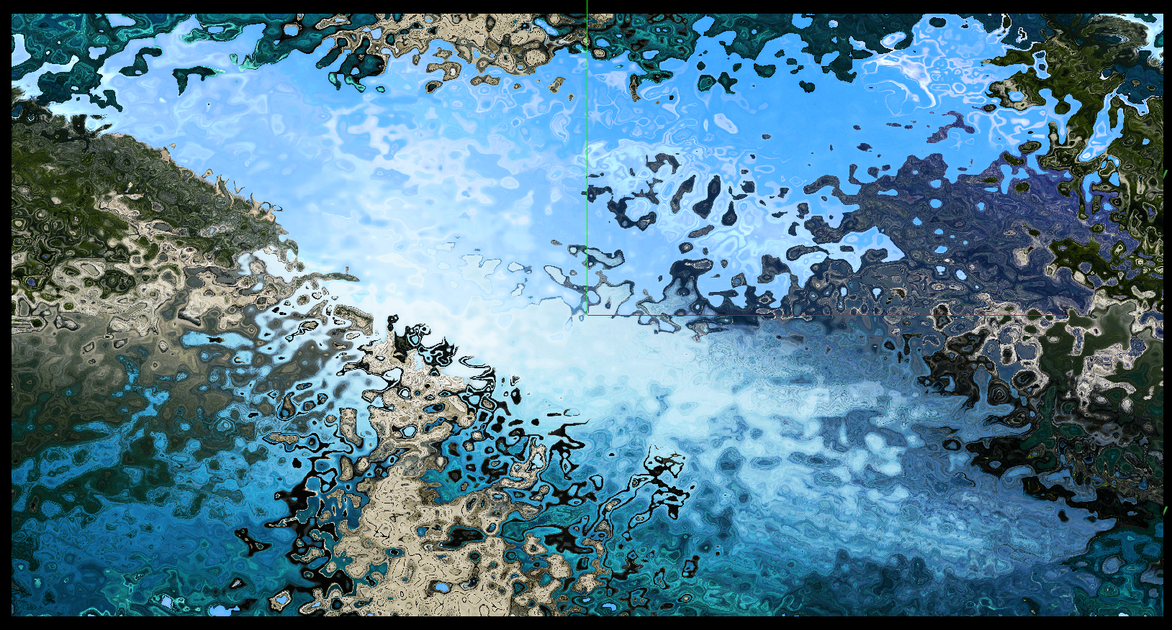
Results
noisevec = (noisevec * 2.0 - 1.0 ) * 0.2;

Slide 14
Challenges
The shader code to convert the RGB information to a displacement vector.

Slide 15
Thank you!

